Slide 1


HIRING PROCESS ANALYTICS
Surani Smit

Slide 2

AGENDA
Project Description
Approach
Tech-Stack Used
Data-set
Insights
Result
120+

Slide 3

Project Description
Hiring process is the fundamental and the most important function of a company. Here, the MNCs get to know about the major underlying trends about the hiring process. Trends such as- number of rejections, number of interviews, types of jobs, vacancies etc. are importantfor a company to analyse before hiring freshers or any other individual. Thus, making an opportunity for a Data Analyst job here too.
Here my task is to analyze the dataset provided by the company to extract the useful insights and draw conclusions about the company’s recruitment process using statisticalanalysis in Excel or in Google analytics
120+

Slide 4
Approach
First, we download the given data .we will clearly understand the data columns and data.
Performing analysis using Microsoft Excel using various in-built formulas and will find the answers for questions asked.
We'll be carrying out exploratory data analysis, or EDA, such as
looking for the duplicates in the data Set if We find any We Will remove duplicate with in-built function Of Excel.
We will check for missing values in the data set as well.
Find out missing values and outliers using quartile function in excel
After removing the outliers further insights were carried out using excel formulas and graphs
120+

Slide 5
Tech-Stack Used
Microsoft Excel: This tool is used to create graphical representation of the results and to understand the result set better.
Microsoft PowerPoint : To create PPT
120+
Data-set :
https://docs.google.com/spreadsheets/d/1gAq5sK8L2e7rCP0O0KaNo7gqx6tfnVQk/edit?gid=1029390730#gid=1029390730

Slide 6
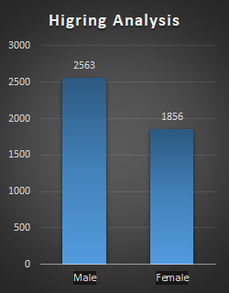

Insights
A. Hiring Analysis: Determine the gender distribution of hires. How many males . and females have been hired by the company?
From the bar plot we can observe that there are total of 2563 males and 1856 females are hired for different positions in the company.

Slide 7
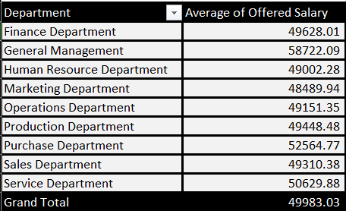
B. Salary Analysis: What is the average salary offered by this company?
Average salary offered in this company is 49,983.03

Slide 8
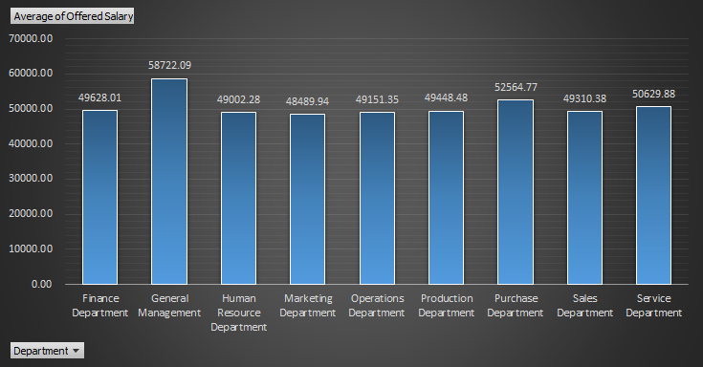

Slide 9
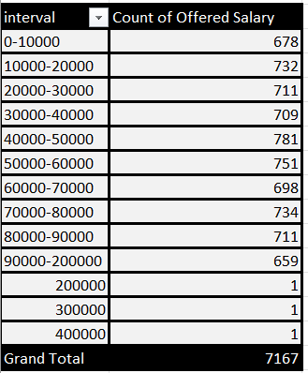
C. Salary Distribution: Create class intervals for the salaries in the company.
Most of the employees are in the salary class interval of 40000-50000.

Slide 10
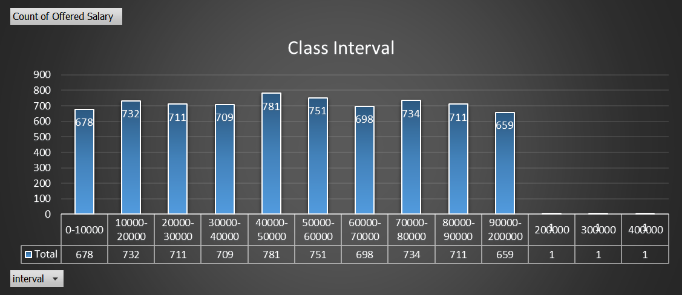

Slide 11
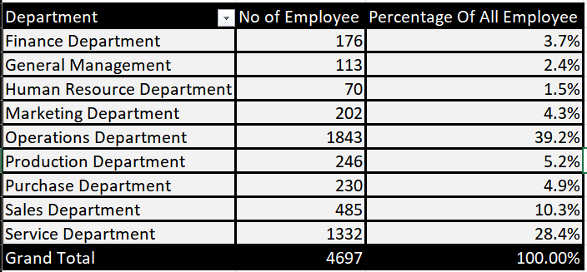
D. Departmental Analysis: Use a pie chart, bar graph, or any other suitable . visualization to show the proportion of people working in different departments.
Operations Department has most number of employees i.e. 1843 comparedto others, where as Human Resource Department has the lowest i.e. 70.

Slide 12
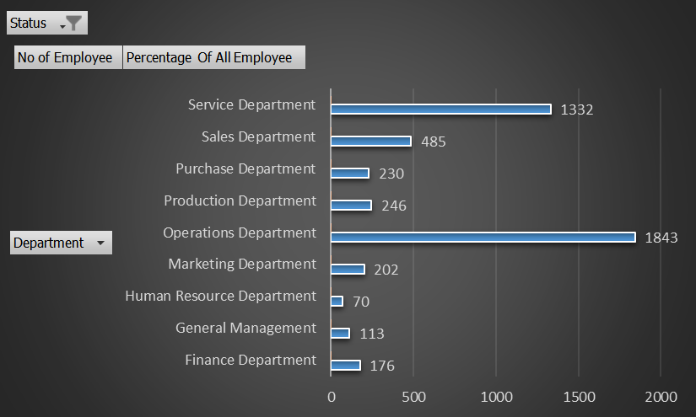

Slide 13
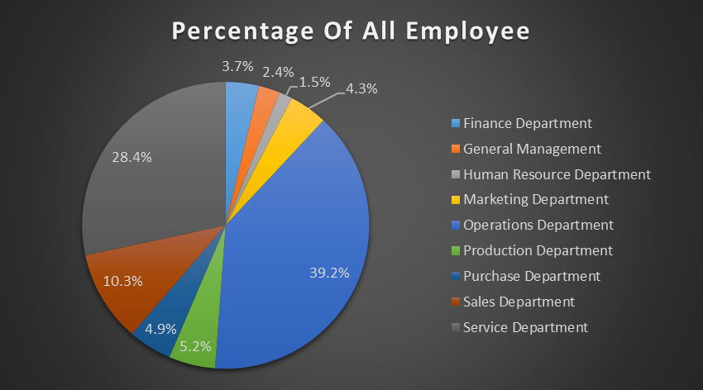

Slide 14
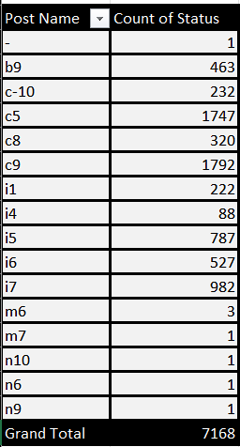
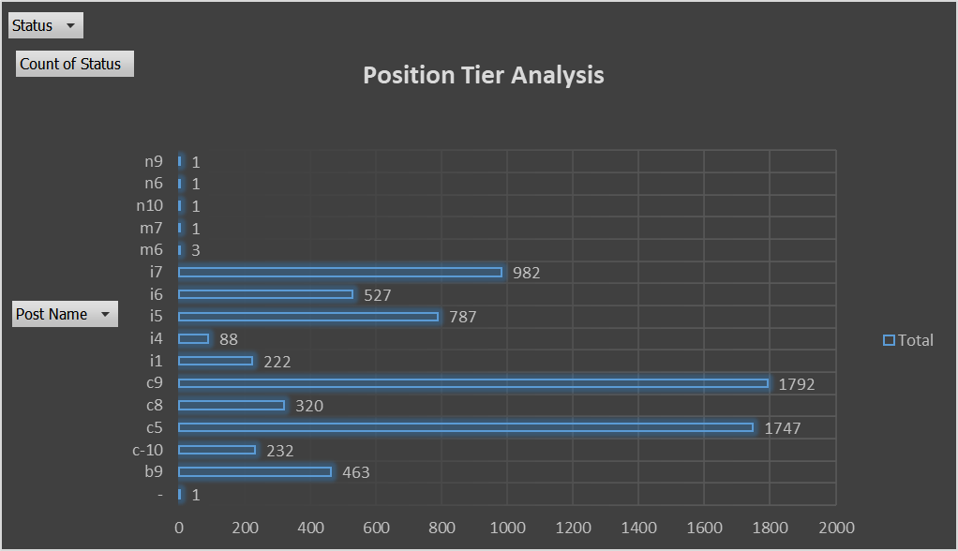
E. Position Tier Analysis: Use a chart or graph to represent the different position tiers within the company.
Most of the employees are in the Post tier of c9 with a total of 1792 Employees.

Slide 15
Result:
The project provide significant insights into the hiring process analytics, contributing to a deeper understanding of organizational dynamics. By analyzing hiring patterns, salary distribution, and departmental composition, actionable insights were obtained to optimize recruitment strategies and drive organizational growth.
Click To Open Excel Sheet
Surani Smit

